Slide 1
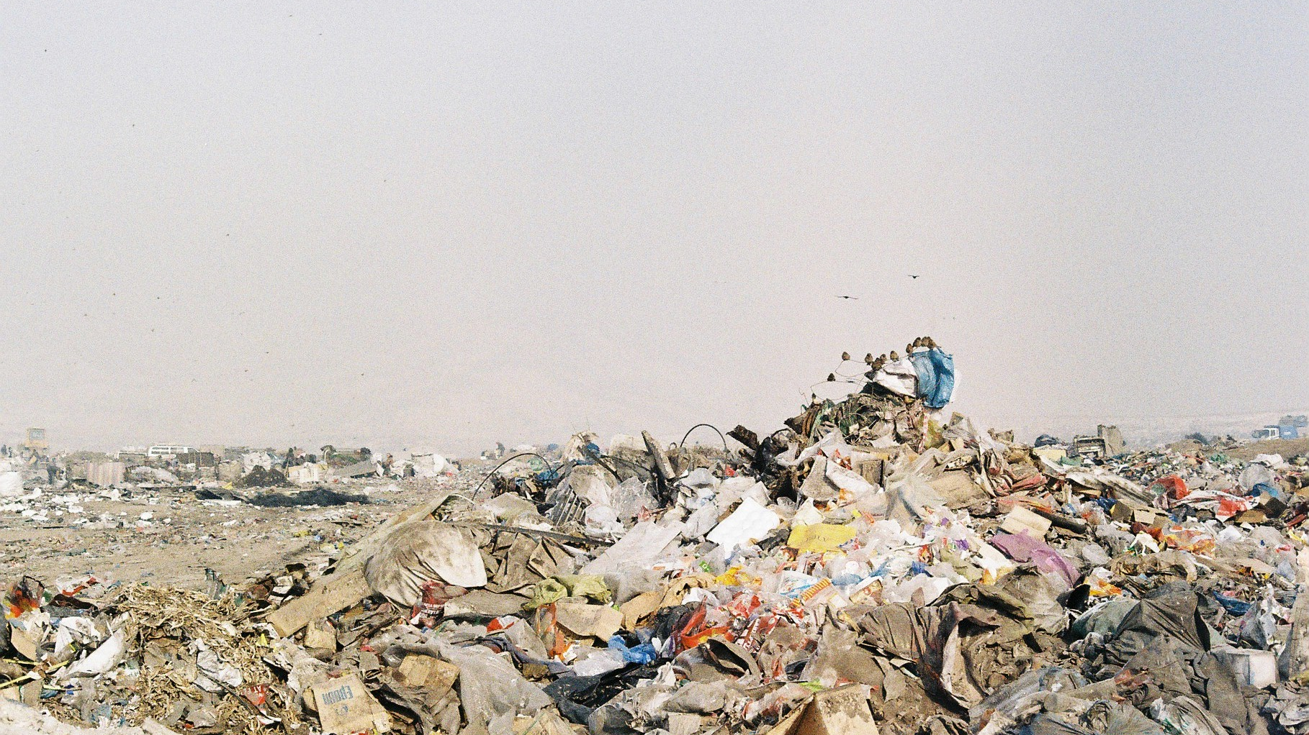


Дахин ашиглах үйл явцыг хянах
Зак Конн, Тогтвортой байдлын мэргэжилтэн
Чех улсын Каритас байгууллагын төслийн туслах ажилтан

Slide 2

Ундааны 30 лаазыг дахин ашигласнаар Prius машин 77 км явахад ялгарах утааг нөхнө ♻️
Notes:
Recycling is the third preference for sustainable waste management after focusing on reducing your waste production and reusing waste has been explored. After you reduce and reuse, recycling is an effective alternative to the landfill and can have significant benefits for the environment. For example: Recycling just 30 aluminium cans offsets the emissions of driving a Prius 77km.

Slide 3
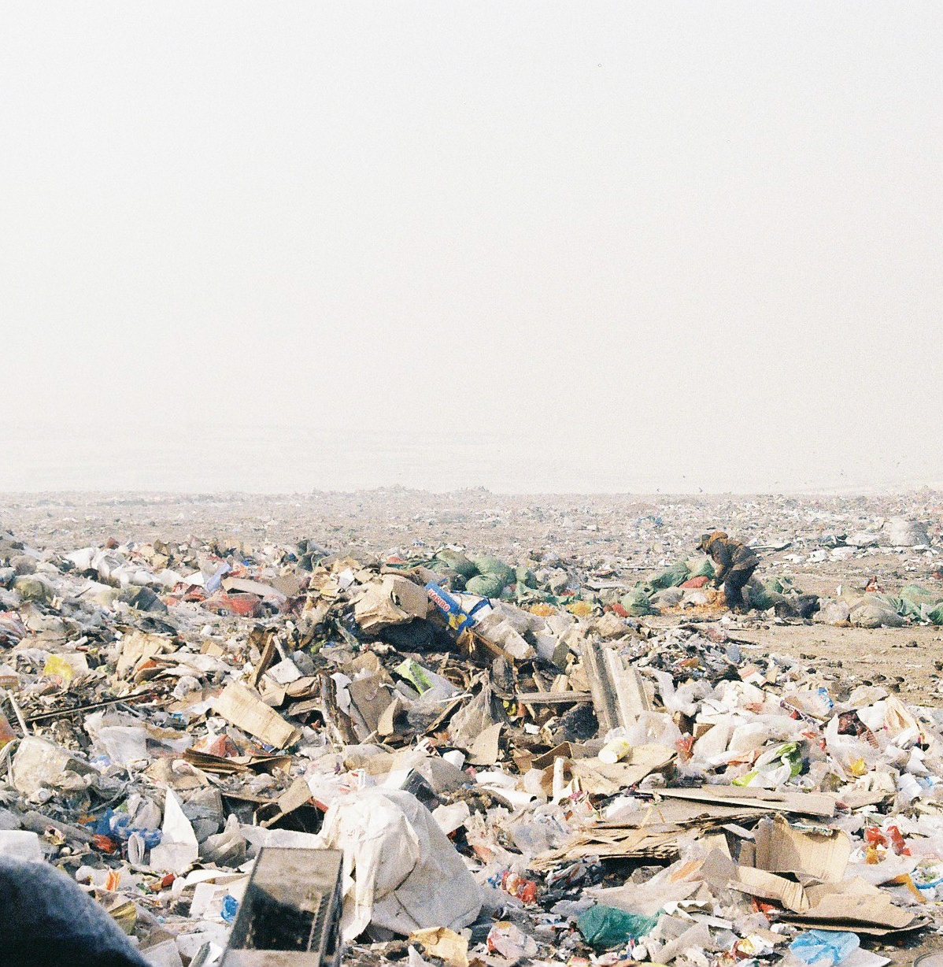
Энэ мэдээллийг хэрхэн ашиглаж болох вэ
Ажлынхныхаа гаргаж буй хичээл зүтгэлийн үр нөлөөг харуулах
Хамгийн их үр нөлөө гаргахад хүч чадлаа дайчлах
Цуглуулсан хэрэглээгээ харуулж ажил дээрээ зан төлөвийн өөрчлөлт гарахыг дэмжих Track trends over time
Эргэн тойрныхондоо та ямар их хичээл зүтгэл гаргаж байгаагаа хуваалц
Notes:
How you can use this data:
There are a few ways you can use the data you collect. I’ll share some specific examples later, to start with though this data collection is an important first step for monitoring how effectively your organisation is managing its waste sustainably. With this data, you will be able to see how your waste stream changes over time.
Without data, you can’t tell whether your efforts are working. This data will empower you to adjust your process to gain the best results and inform you which waste stream you can make the most significant improvements.
If you are making excellent progress on a waste stream, you can make posters showing this to your staff. Recycling can feel like an extra effort to some people and seeing the results of this effort will help keep them motivated.
Recycling is not a widespread practice here, that’s why it is so critical that we act as role models for other organisations and demonstrate it is possible and it is worth the effort. You can share this data on your social media pages or at events to shift recycling from the fringes to the mainstream. We are early adopters and it’s up to us to act as leaders in sustainability.

Slide 4
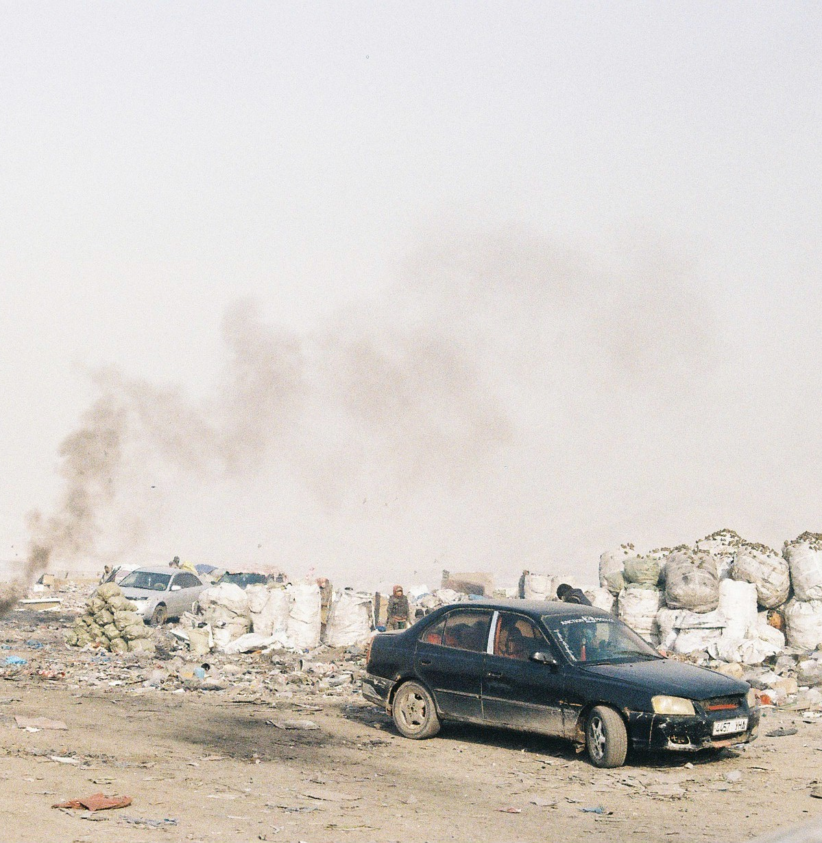
Энэ мэдээллийг яаж ашиглаж болохгүй вэ
Be cautious of accidentally greenwashing
Энэхүү мэдээлэл нь таны гаргаж буй хүчин чармайлтын байгаль орчны эерэг үр нөлөөг хэтрүүлэн үнэлэх магадлалтай.
Тэгэхээр үүнийг ялгаруулж буй утааны хэмнэлтийг тоймлон тооцоход ашиглана.
Энэхүү мэдээлэл нь АНУ-ын дахин ашиглалт, эрчим хүчний үйлдвэрлэлийн тооцоонд үндэслэсэн бөгөөд энэ талаарх Монгол Улсын мэдээлэл гарвал уг хяналтын хүснэгтийг шинэчилж болно.
Энэ нь таны дахин ашиглахаар цуглуулж буй зүйлийн хэмжээнд нөлөөлөхгүй
Notes:
There is a significant disclaimer we need to address though.
This data is powered by the iWarm tool developed by the United States Environmental Protection Agency. This limits the accuracy of the calculations significantly. The energy savings formulas assume we have an electrical grid and recycling industry that operates like the American system. Our system is emerging and becoming more advanced, but we likely do not have the same efficiency as the American systems. This means that the carbon and energy savings are not accurate and are estimates at best. They are still useful benchmarks, but should not be used for carbon accounting.
This does not impact the kilograms of waste you are tracking. At the end of a year of tracking, you can confidently and accurately you recycled 200 kilograms of plastic if that is what the chart says.

Slide 5
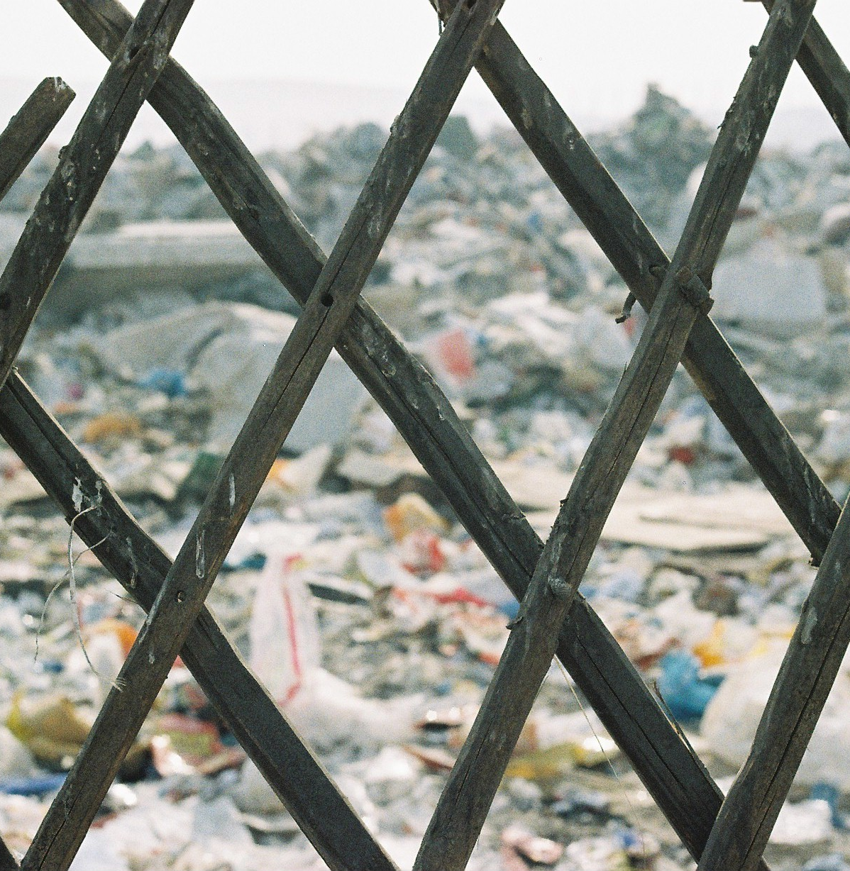
Санаачлагатай байх
Хог хаягдлын аудит хийн хаягдлынхаа бүрэлдэхүүнийг мэдэж авснаар цаашид хэрхэн сайжруулахаа хянах боломжтой
Notes:
Getting creative:
The effectiveness of your monitoring efforts will be significantly improved if you start this process with a waste audit for your office.
You can do this by collecting all the waste, including waste that cannot be recycled, from your whole office for 1 week of normal operations. Select categories of waste that are relevant to the scale of recycling you will do, you may choose to divide the week of waste collection into non-recyclable waste, PET plastics, HDPE, glass, paper and cardboard, and LDPE (soft plastic).
You may go an extra steps further and divide non-recyclable waste into further categories like electronic waste, mixed packaging, and organic waste to enhance your waste management strategy. Organic waste can easily be recycled in your office onsite if you set up a composter and has signification positive impacts for the environment.

Slide 6
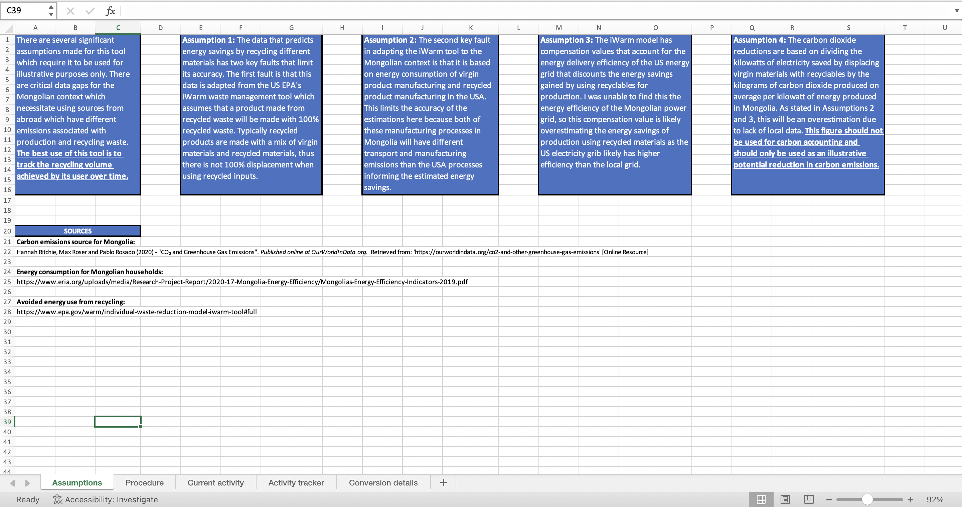
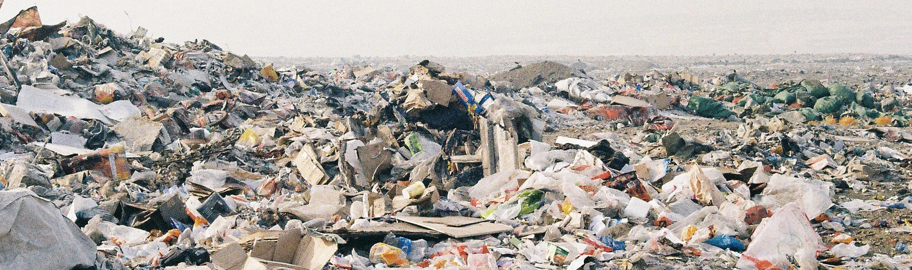

Дахин ашиглалтаа хэрхэн хянах вэ
Үгүйсгэл, таамаглалын хэсэг
Notes:
So on to the tracker. The first sheet on the tracker gives specific details about how this tool was made, what assumptions are embedded in the formulas, and how it can and can’t be accurate.

Slide 7
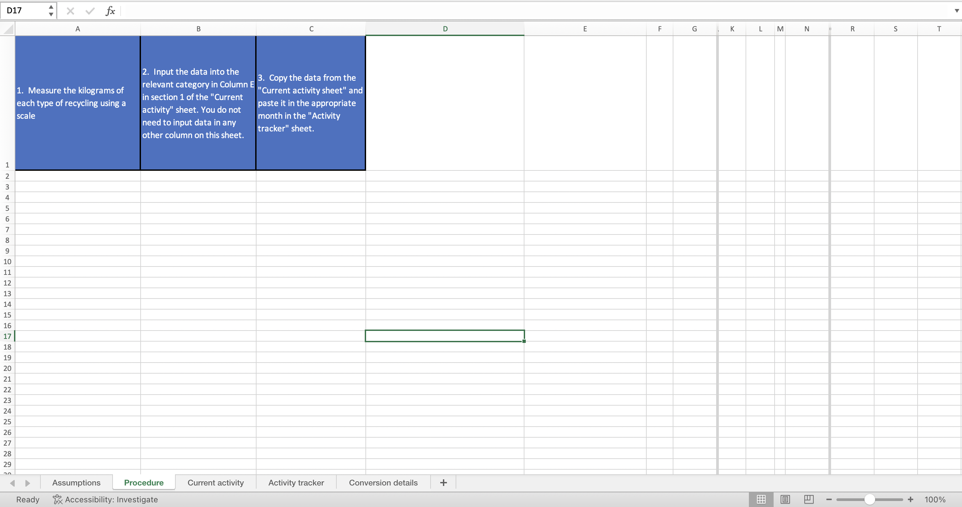
Дахин ашиглалтаа хэрхэн хянах вэ
Зааврын хэсэг
Notes:
The second sheet outlines the 3 steps required to use this effectively. First you need to measure the weight in kilograms of each category of recyclable waste. Second you input these weights in the next sheet on this spreadsheet. Last you copy this data into the monthly tracker to see long term trends.

Slide 8
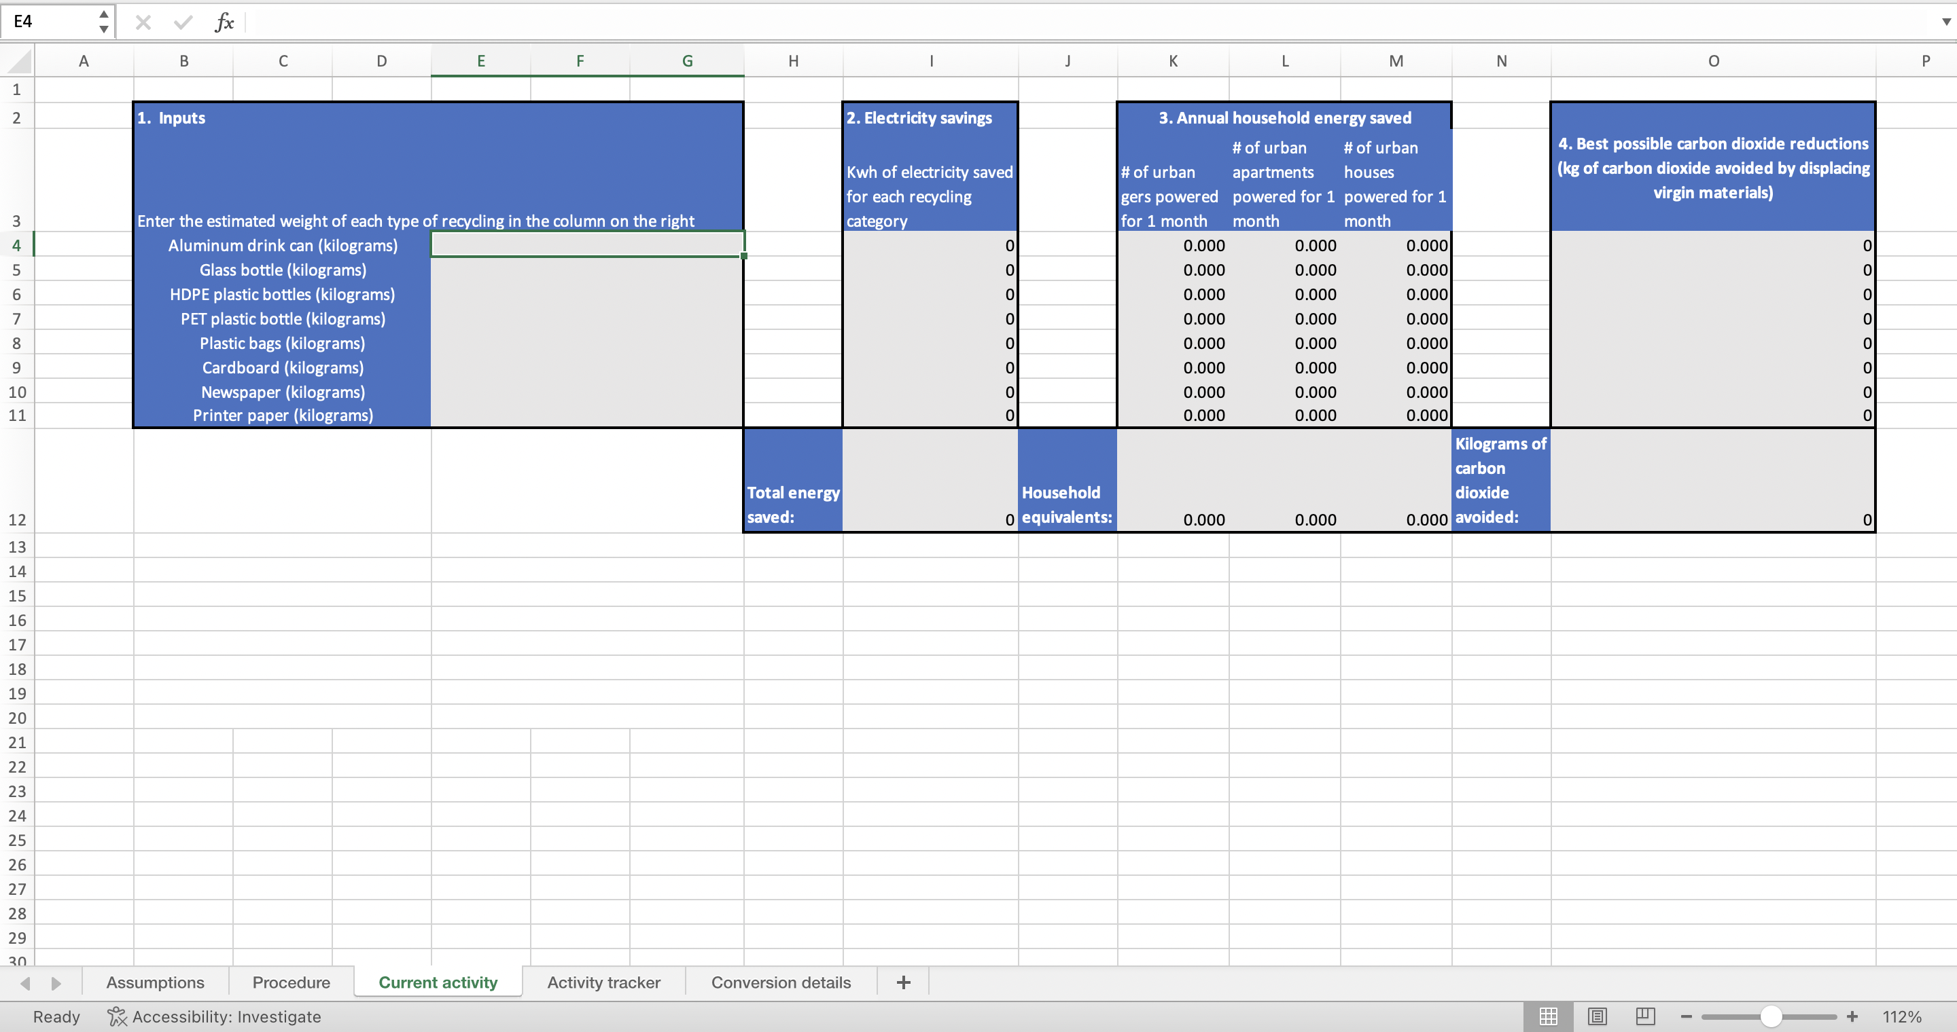


Дахин ашиглалтаа хэрхэн хянах вэ
Үр өгөөжөө тооцоолох хэсэг
This is the only field you need to enter data in
Notes:
The third sheet is where the magic happens. Within the red cycle you input the weight in kilograms of each class of recycling you have collected over 1 month.
The rest of the sheet automatically gives you different estimates about how much electricity you have saved by recycling, how much carbon emissions you have saved by displacing new plastics with recycled plastics, and how many homes or gers in urban Ulaanbaatar you could power with the electricity you saved. The amount of carbon emissions saved is based on the carbon emissions from Ulaanbaatar’s coal power plants.

Slide 9
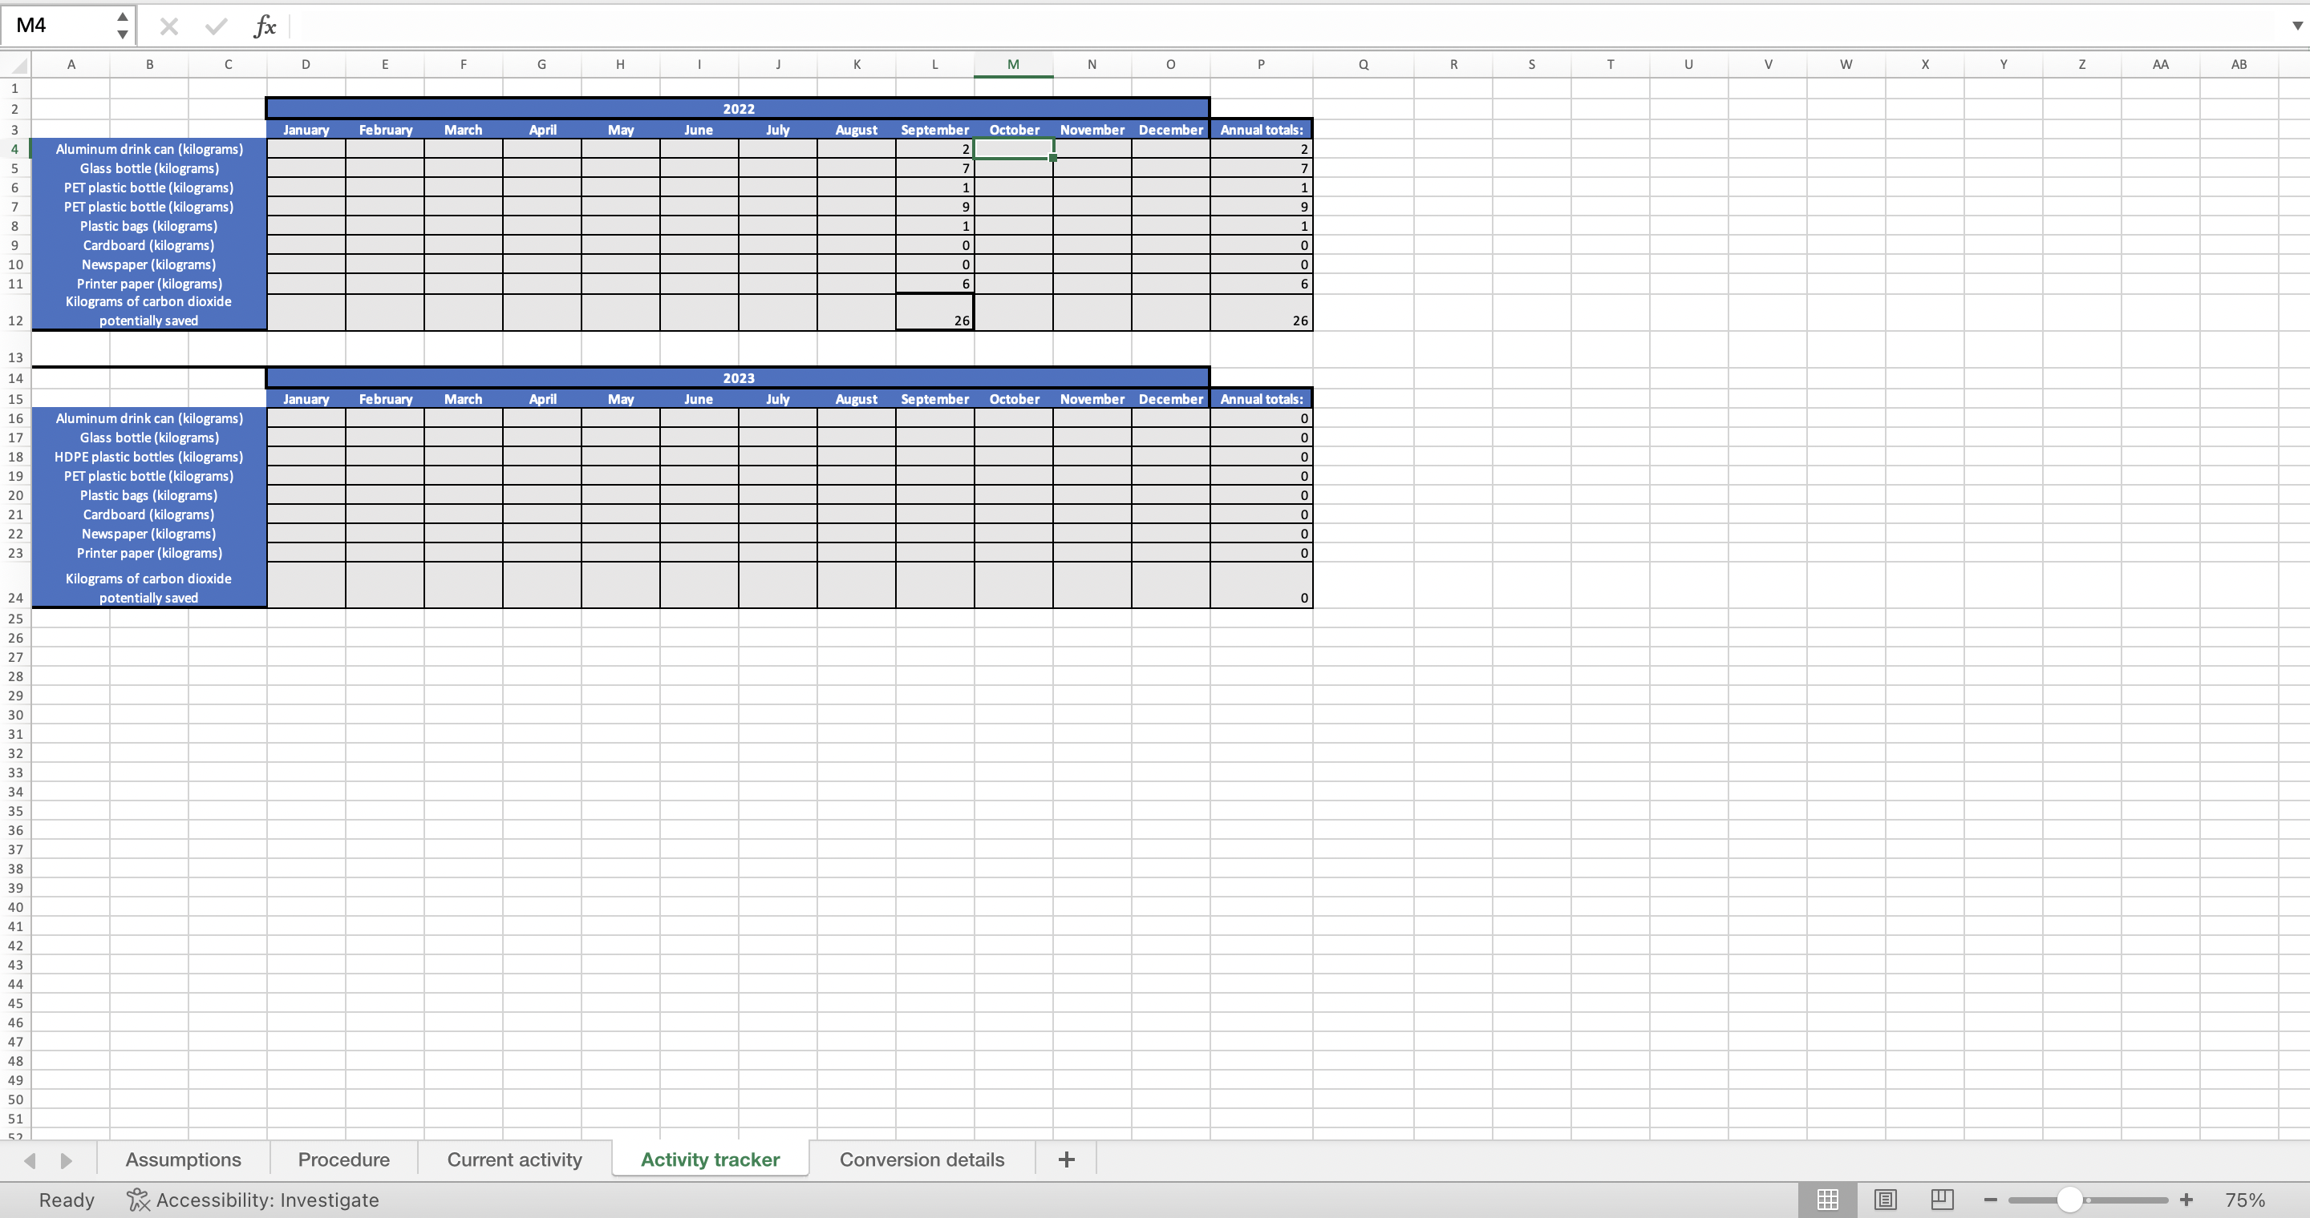




Дахин ашиглалтаа хэрхэн хянах вэ
Хугацааны хэсэг
This column automatically adds up how many kilograms of each waste type has been recycled over the year
Copy the kilograms of waste from the previous step in the appropriate month
Notes:
On the fourth sheet you can keep track of how many kilograms you recycled each month based on recyclable type and an estimate of how much carbon you saved each month with your efforts.
You simply copy and paste the kilograms you put in the red circle on the last step into the black circle on this step. If you also want to track carbon emissions potentially saved, copy and paste that value into the last row in the table under the appropriate month. The green circle automatically adds up the annual kilograms of recycling and carbon emission estimates and will tell you at the end of the year how many kilograms you have recycled.

Slide 10
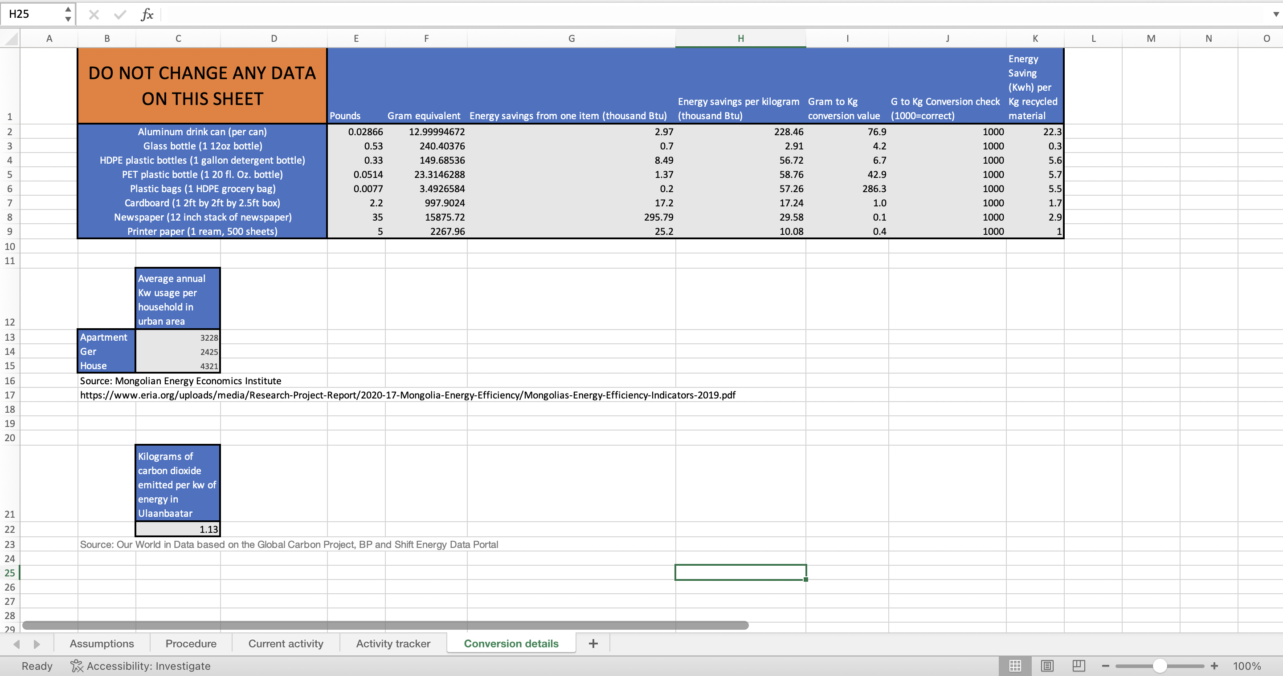
Хэрхэн тооцоолдог вэ
Notes:
The last sheet should not be changed or edited ever. This sheet is what powers the formulas on the other sheets and provides the sources of the data used.

Slide 11


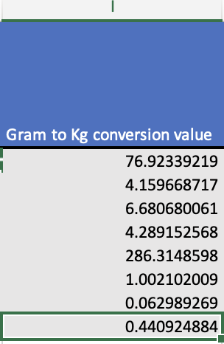
Хэрхэн тооцоолдог вэ
дэлгэрэнгүй
1 aluminium can in kg
0.012999947
How many cans are in a kg
76.92339219
How much savings btu (thousands) from one kg
228.4624748
Notes:
Let’s dive a little deeper. The data here is powered by the US Environmental Agency’s iWarm waste management tool, the data taken directly from this tool are shown with the white arrows.
The green arrows indicate where I have converted the iWarm tool to kilograms to make this tool easier to use. The iwarm tool requires counting each piece of waste, so for ease of use I’ve scaled this up so you can track based on kilos of each waste type instead of by item.

Slide 12
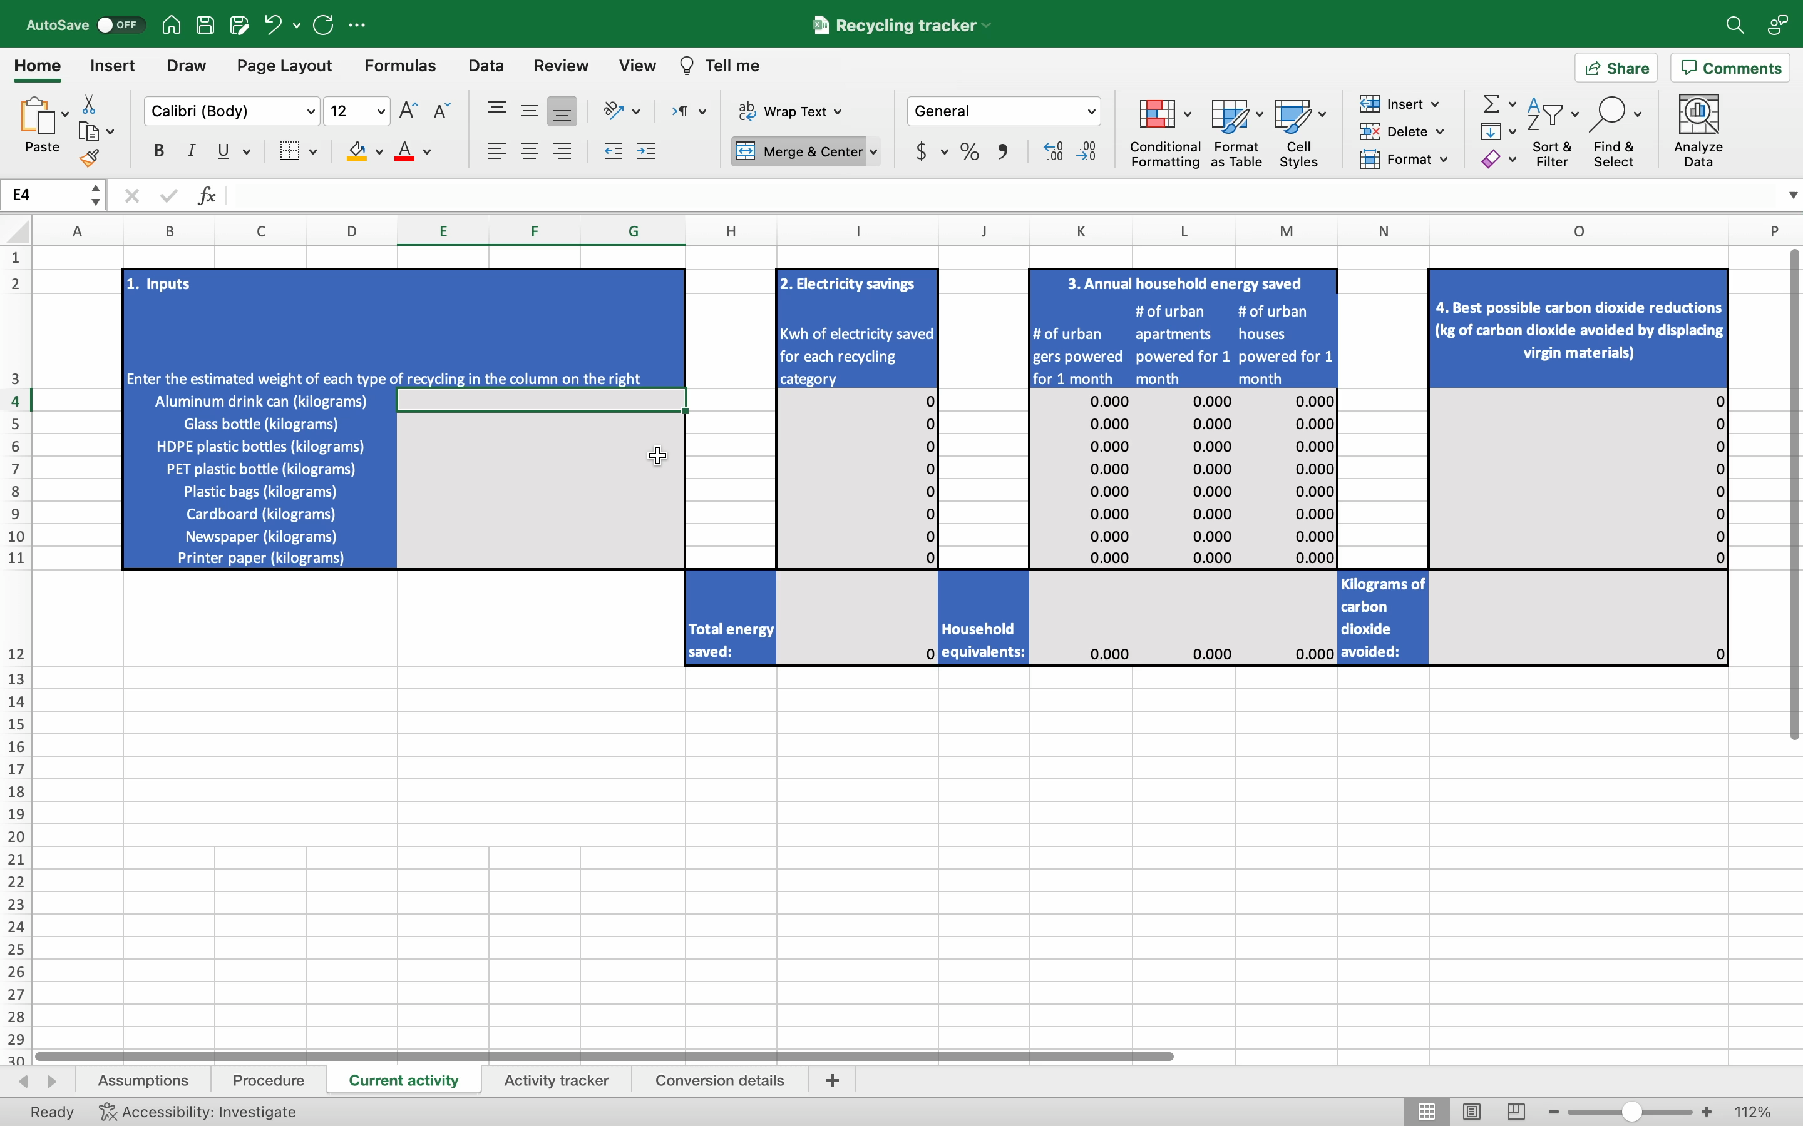
Дахин ашиглалтаа хэрхэн хянах вэ
Үйл явц
Notes:
So let’s see this in action.
These slides will be provided to you at the end of today’s session so you can always refer to them or share them with whoever is responsible for your waste management activities.

Slide 13

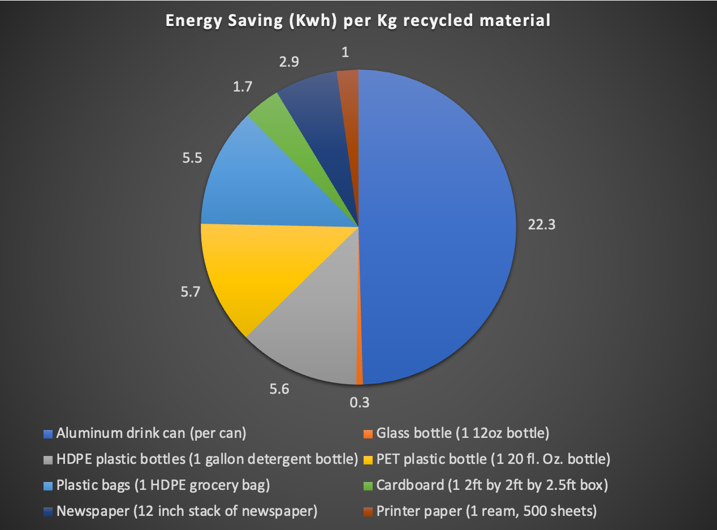
Мэдээллээ хэрхэн ашиглах вэ
Зорилгодоо чиглэх
Хог хаягдал бууруулах?
  Хүчин чармайлтаа хамгийн их хэмжээтэй гардаг хаягдалд төвлөрүүлэх
Нүүрс хүчлийн ялгарлыг бууруулах?
  Утааны ялгарлыг хамгийн их нөхөх хог хаягдалд анхаарах
Notes:
How can we use this data to focus our actions for the most impact? If your main goal is waste reduction, you start by looking for either the highest number of items of a waste type or the waste type with the highest weight. Let’s say that PET plastic like coke bottles are the majority of your recyclables. You could put up posters in your offices encouraging people to buy the reusable coke bottles or encourage people to use reusable water bottles instead of single use plastic water bottles.
If energy savings and carbon emission reduction is your focus, you can see by this chart that aluminium cans, shown in dark blue on the right, are the greatest opportunity to save energy and emissions. The next best focus to save energy and carbon is PET plastic bottles and HDPE plastic bottles and bags, shown in yellow, light blue, and grey. If you focus on these waste streams, you can be confident you are targeting the highest energy savings.

Slide 14

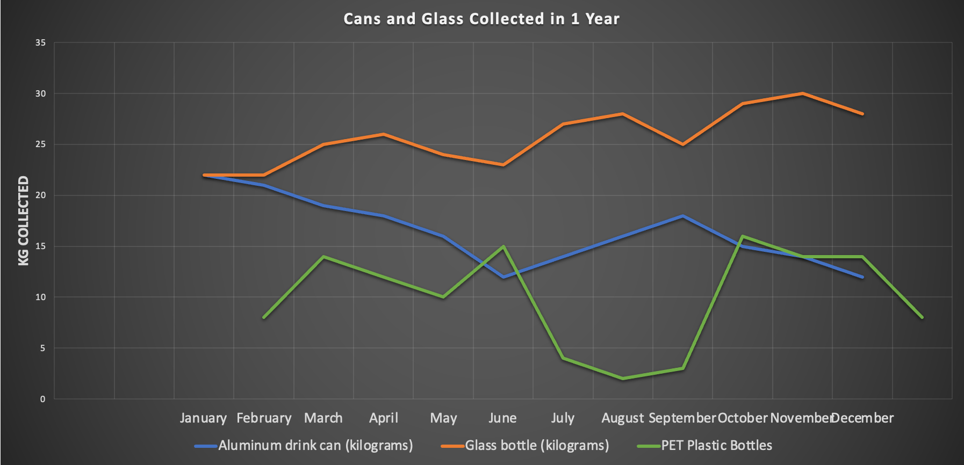
Мэдээллээ хэрхэн ашиглах вэ
Менежментдээ анхаар
Хог хаягдалд улирлын чанартай өөрчлөлт гарч байна уу?
Төлөв нь нэмэгдэж байгаа зүйл байна уу, хэрхэн шийдэх вэ?
Сайтар шийдэж байсан хог хаягдалд дахин анхаарах хэрэгтэй байна уу?
Notes:
What next? How do we take these numbers and make them meaningful? After you have several months of data, you will start to be able to see rough trends. The longer you use this tool, the more accurate the trends will be.
If you have a year of data, you will see how waste streams change with seasons. This allows you to predict what waste will increase and let you focus your communications. If you know during summer the number of PET bottles increases for example, you can put up posters in May reminding staff to bring their reusable water bottles to work or other options to plastic bottles.
Often office recycling efforts start strong as people are most aware of them when they begin, but this momentum can slip as time goes on. Our current waste habits are built on years of throwing things away, behaviour change takes time, reinforcement and encouragement. Incentives are also a powerful tool to encourage your staff to stay committed. You may consider giving prizes to departments that can show they have reduced waste.
But if you can see in the data, shown as an example with the blue line, that you were really effective at recycling aluminium cans at the start of the year and then aluminium can recycling drops, you might need to remind staff that recycling cans is important. Before reminding them, check that there are more cans than before in the general waste though, because a drop in can recycling might also show that your encouragement to reduce waste generation might have been effective. People may just have stopped buying as many cans as before they knew the environmental impact.
This is why starting this process with a waste audit is useful, without the waste audit you don’t know whether people are consuming less or recycling less. You don’t have the baseline to understand what to expect in your general waste.

Slide 15
Үйл явцыг хэрэгжүүлэхэд бяцхан зөвлөгөө
•5кг юм уу 10 кг хог хаягдал ямар харагддаг зургийг авч мэдээллийн өгөгдлийг түргэсгэх
  Ингэснээр цуглуулж байгаа хог хаягдлаа дахин дахин жигнэхгүйгээр хэмжээг нь тооцоолох боломжтой болно.
  Танай үйл явц, зорилтоос шалтгаалаад зөвхөн 1 юм уу тодорхой хэдэн хог хаягдлыг хянахаар сонгож болно.
Та энэ арга хэрэгслийг өөрийн үйл явц, хэрэгцээндээ тохируулан хэрэглэж болно.
Танд тустайгаар хяналтын хүснэгтэд хийх өөрчлөлт байвал танд туслахдаа баяртай байх болно.
Notes:
Recycling takes effort and human resources, let’s explore how you can make this easier.
To begin with, designate someone an office Sustainability Champion who is responsible and accountable to communicate with staff about recycling, to collect the recycling, and fill in the tracker. The communications are critical to inform staff of when they are doing the right thing, but also when they are not sorting waste properly. Contamination of recycling with non-recyclables can mean all the recycling in that bag is rejected and sent to the landfill. Everyone needs to be onboard and informed for recycling to work.
You can make the Sustainability Champion’s job easier by weighing 5 or 10 kilograms if each waste type and taking reference photos of what this looks like. This will mean they don’t need to weigh each waste type every time they collect it. If they can look at a bag of bottles and know what 5 kilos of bottles should look like, this will save them a lot of time and effort that would be spent weighing them.
You may choose to only focus on a few high impact waste streams and only collect PET, glass, and HDPE if resources are limited.
The key is that this tool is there to help you, you can use it the way that best fits with your overall strategy. If you have changes to the tool that would be helpful, I am happy to adapt this to make it more useful to you.

Slide 16
УБ-ын хүн бүр хог хаягдлаа дахин ашиглавал хогийн цэгт ирж буй хог хаягдлын 23.2%-ийг гаргахгүй байх боломжтой
•Миний хаяг: zachary.conn@caritas.cz
•Асуулт, санал
Notes:
If everyone in UB recycled, 23.2% of all waste to landfill would be avoided.
Recycling is an essential part of sustainable waste management. It reduces oil and natural resource consumption, it reduces carbon emissions, and it reduces land and air pollution at dump sites. While it might feel like a lot of effort to go through, we are leading the movement together and showing the our city is committed to sustainability. This is a critical role to play to demonstrate that UB is ready for a centralised recycling scheme.
Thanks for your time, please feel free to contact me with ideas to improve this tool or if you have any questions. Does anyone have comments or questions to share?

Slide 17
Эх сурвалж
Waste composition in UB in Mongolian:
https://asiafoundation.org/wp-content/uploads/2020/02/Улаанбаатар-хотын-ахуйн-хог-хаягдлын-найрлагын-Бутцийн-судалгаа-2019.pdf
Waste management training in Mongolian by EcoSoum:
https://15f3d748-2925-4833-8332-67a1581fa971.filesusr.com/ugd/55e3ff_39edeb0b0a454f448f450fd0e4ea5fb7.pptx?dn=ЭКОСУМ%20–%20ХОГНЫ%20ТУХАЙ%20ЯРИЛЦЪЯ%20СУРГАЛТ%20–%202021%20оны%209%20сар.pptx
EcoSoum Toolkit for waste management and how to conduct a waste audit:
https://drive.google.com/file/d/1DbwKC20mZH-KFxAWypQj3aQfuMlnKl2X/view?usp=sharing

